Slide 1


Developing skills:
Note-taking
Guided Tours
Lesson 1

Slide 2
How well can you take notes while listening?
I can do it …
… easily and very well | +4
… quite easily and quite well | +3
… with difficulty but OK | +2
…with difficulty and badly | +1
I can’t do it. | 0
I don’t know. I never tried | ?
Notes:
This is a simple pre-test, to give the Ss the opportunity to think about whether they can do it and how well.
Read the can-do statement and give them a moment to note their score.
NB don’t forget to return to this at the end of the lesson

Slide 3
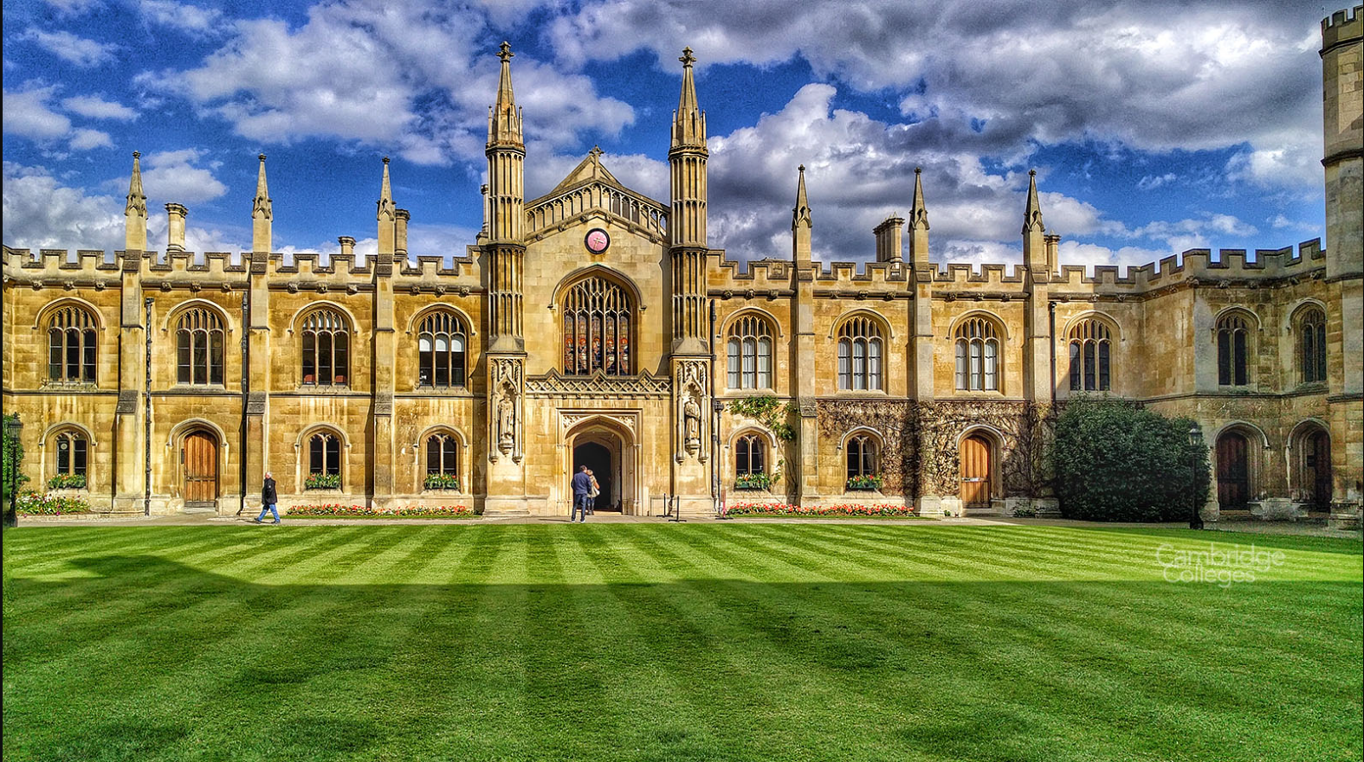

Slide 4
In this lesson we’re going to
use ‘information units’ to help improve your note-taking
listen to a tour guide giving a commentary
take notes while listening to the tour guide’s commentary
(tell your friend what you learnt from an audio guide)

Slide 5
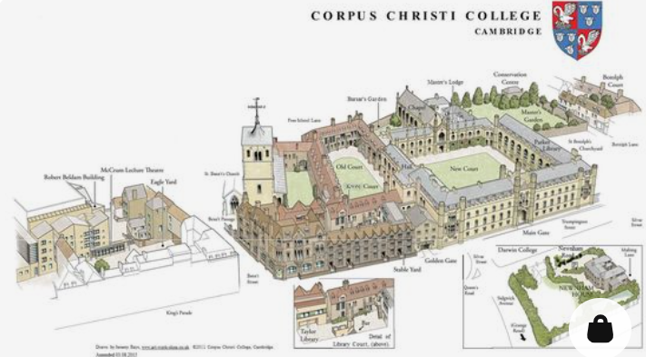

Listening and notetaking
Working individually, and then in groups
Listen to the tour guide giving a commentary (no note-taking)
After listening, what do you remember?
Working individually, make notes of what you remember.
Form groups of 3 – 4, share what you remember.
Listen again to update your notes and add any new details you notice

Slide 6
Information Units [I.U.s]
An information unit [I.U.] is the smallest unit of knowledge that can stand as a separate assertion that can be judged as true or false. I.U.s include, for example, the name of a person, place or concept. It could also be a fact, a definition, or an example.

Slide 7
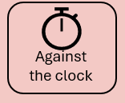
Chunking a transcript
Information Units
Work alone and then compare with others
Chunk the transcript: put a slash [/] on the transcript to indicate IUs.
Compare and discuss your choices in groups of 3-4.

Slide 8
Chunking the transcript
OK. I want us to imagine that we've just walked past Fitzbilies cake shop and we're walking towards Corpus Christi College, and we'll stop here for a minute.
Notes:
Do the first sentence to demonstrate the task
Give them a copy of the word doc text and ask them to do the first paragraph. Class check, next slide (slide 8) and then ask them to mark the rest of the transcript. There is a word doc copy of the completed chunking..

Slide 9
Chunking the transcript
OK. / I want us to imagine / that we've just walked past / Fitzbilies cake shop / and we're walking towards/ Corpus Christi College, / and we'll stop here / for a minute.
Notes:
Do the first sentence to demonstrate the task
Give them a copy of the word doc text and ask them to do the first paragraph. Class check, next slide (slide 8) and then ask them to mark the rest of the transcript. There is a word doc copy of the completed chunking..

Slide 10
Chunking the transcript
OK. / I want us to imagine / that we've just walked past / Fitzbilies cake shop / and we're walking towards/ Corpus Christi College, / and we'll stop here / for a minute.
Corpus Christi / was founded / in 1352, / and it makes it / the 6th oldest College in Cambridge. What is really interesting about Corpus is / that it was the only college in Cambridge / founded by the townspeople./ If you think about the other colleges, / they were founded / by kings / or other rich patrons, / whereas Corpus is different.
The other thing that's really interesting about Corpus / is Old Court. / So if we were allowed inside, / and unfortunately the college is closed / to visitors at the moment, / we will see old court / and it has / beautiful surviving mediaeval buildings / from the 1350s.
In fact, / it is the oldest inhabited courtyard / in the country,/ so this is Corpus's other claim to fame.

Slide 11
Mark the transcript
Main ideas
Supporting ideas
Transitions
Examples
Redundant elements

Slide 12
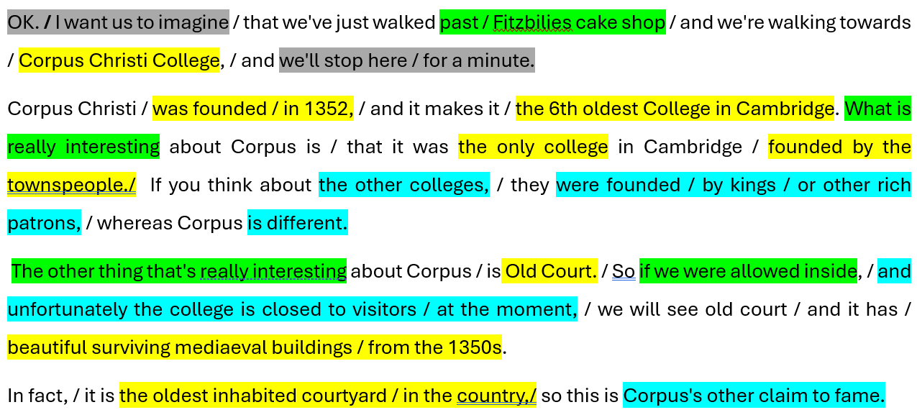
Mark the transcript

Slide 13
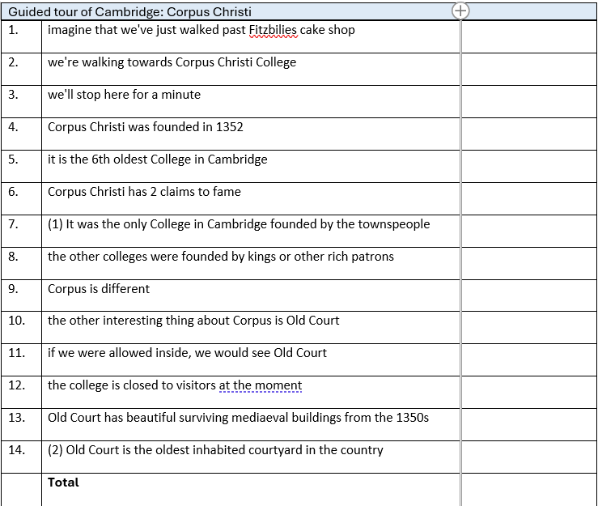
1 = information included in notes, | 0 = information missing from notes, | -1 = Wrong information included in notes
Guided tour of University of Vilnius
1 | seen Vilnius University on the screen—in a movie or TV series
2 | university often used as a location for historical films
3 | Vilnius University is the oldest and largest university in Lithuania
4 | one of the oldest in Eastern and Central Europe
5 | established during the era of the Polish-Lithuanian Commonwealth
6 | during the second half of the 16th century
7 | the Jesuits founded a college
8 | which later, in 1579, was reorganized into a university
9 | the university spread Latin, Catholicism,
10 | book printing, and Lithuanian writing
11 | along with cultural and scientific innovations
12 | involvement in the European space of science and education
13 | the middle of the 18th century, the university had its on observatory
14 | third-best observatory in the world
15 | after Greenwich and Paris observatories
16 | Vilnius University library is the oldest and one of the biggest in the country
17 | they preserve the first Lithuanian book, ‘Katekizmas,
18 | published in the 16th century
19 | only two copies
20 | one here and another in Poland
Notes:
Visual aid to accompany word doc I.U. grid given to students

Slide 14
In pairs within your group
Information Units [IUs]
Return to your notes: use the IU grid and mark your notes.
Divide by 14 and multiply by 5. What’s his/her score out of 5?
What is your total score? How complete are your notes? Compare with others.
I | Information included | +1
M | information missing | 0
W | information is wrong | -1
5 | Outstanding | Complete
4 | Good | Mostly complete
3 | Satisfactory | Half of the info included
2 | Below par | Some info included
1 | weak | Little or no info

Slide 15
Review and Reflections on note-taking
Discuss with a partner
Chunking a text is easy agree / neutral / disagree
Taking notes as a list of I.U.s is easy agree / neutral / disagree
Collaborating helps to fill in the gaps agree / neutral / disagree
It’s better to write more, not less, when note-taking agree / neutral / disagree

Slide 16
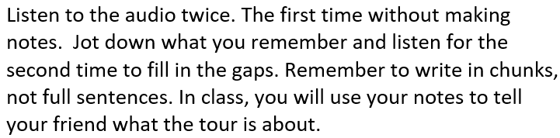
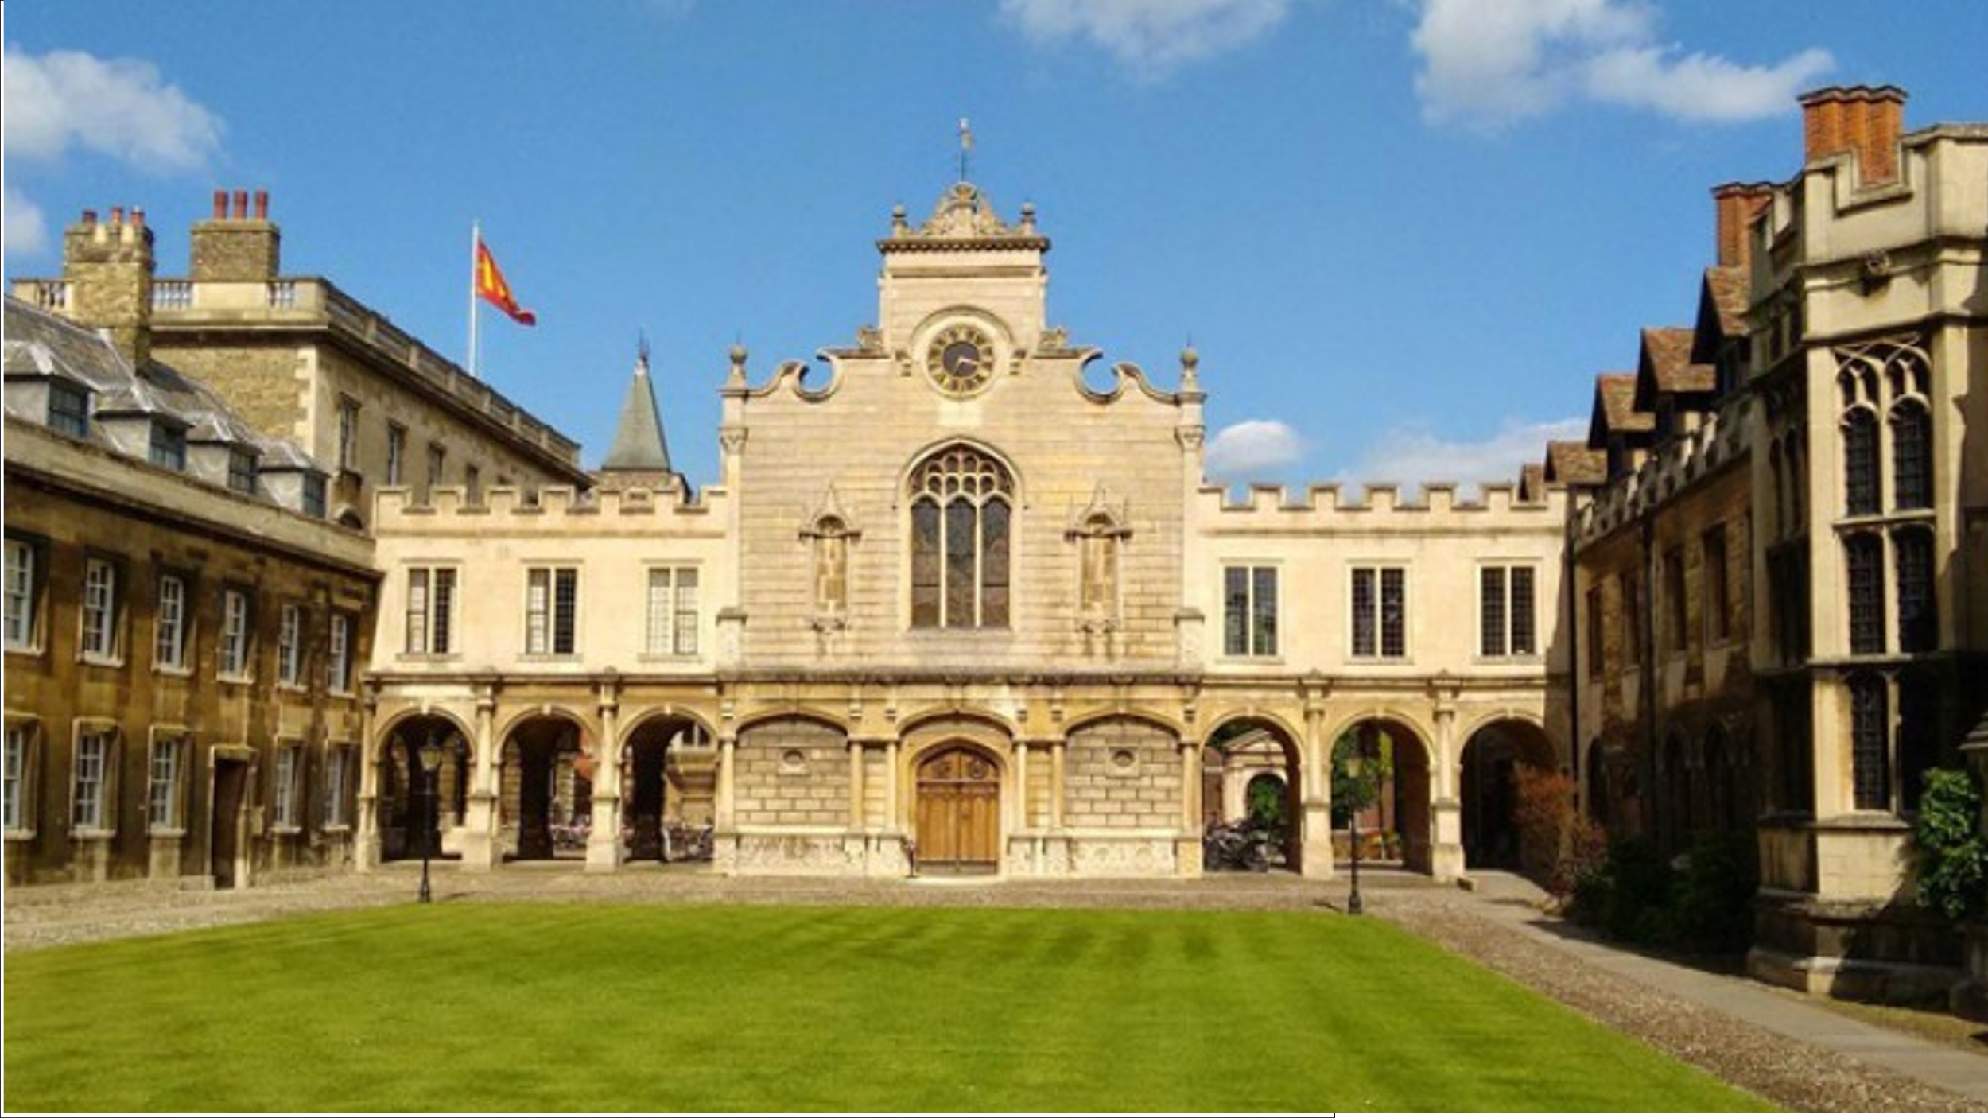

Homework task

